Slide 1
SIPOC Diagram
What is SIPOC Diagram?
A SIPOC provides high-level understanding of a processes you use by identifying Suppliers, Inputs, Process, Outputs, and Customers. It’s a tool for summarizing the flow of inputs and outputs of a processes.
Instructions:
Begin by filling out the center column with the beginning and ending to establish the boundaries of your process.
Next, summarize your process into 4 to 6 high-level steps between the start and end of the process. This is often called the Macro Process and should be seen as an overview of the work.
In the Supplier column list the people or entities that provide the inputs to the steps of your process and each step should serve as a short list of groups that provide you with information or goods.
In the Inputs column list the items or information these suppliers provide you with to generate the outputs. This could include materials, resources, documents, data or even formal requests required to carry out the process.
The Output(s) column is for the results of the process step or activity. This is resulting “product” of your work, and could be a verification email, physical document, generated report, or other output materials.
In the Customer column list the people or entities who receive and use the outputs you’ve produced or are directly impacted by the result of the process step. Similarly to the supplier column, there may be more than one customer for each step and your customers and suppliers may end up being the same groups/individuals.
After you identify your process steps, you and your working team may find it easier to complete the remaining columns out of this prescribed order. Try completing the input or output columns next as you complete the table.
Tip: Keep one of these two sentences in mind if you struggle completing this template:
Suppliers will Input-X to my Process so I can Output-Y to the Customer.
The groups I work with give me “X” and my work will result in “Y” for the next group.

Slide 2
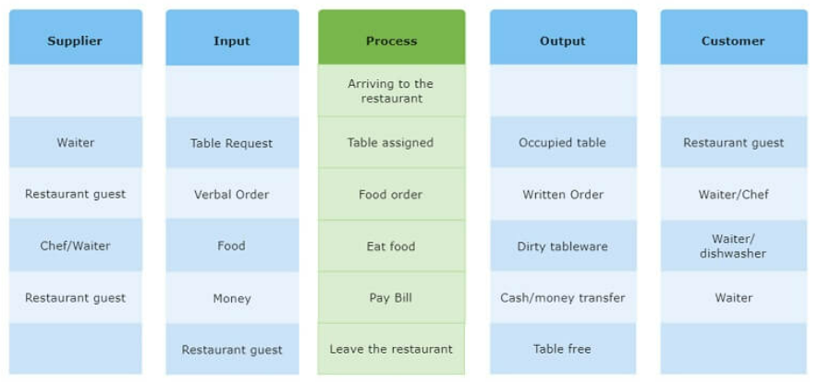
SIPOC Example:
Dining at a restaurant
Date: 09/15/2023

Slide 3
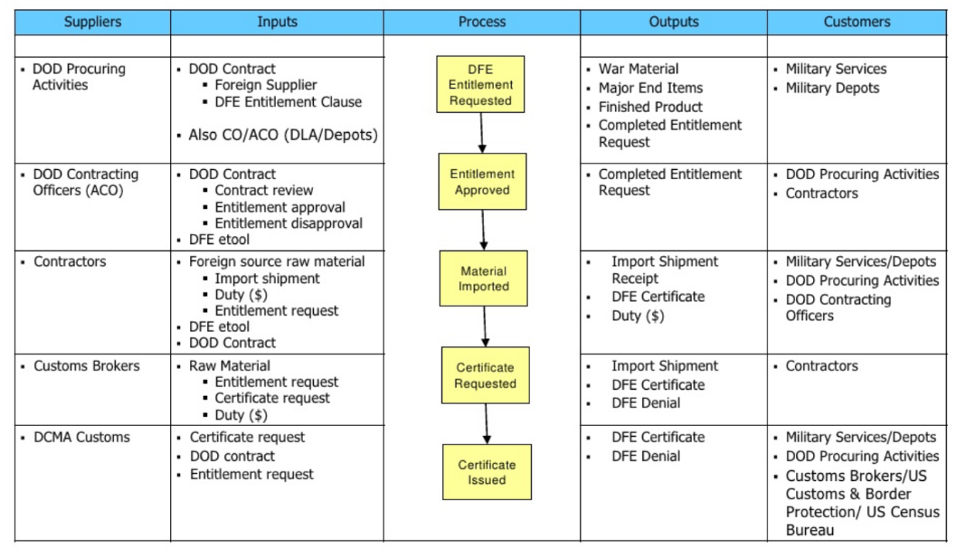
SIPOC Example:
Duty Free Entry Certificate
Date: 09/15/2023

Slide 4
SIPOC Worksheet
Process Title:
Created on:
Suppliers
Inputs
Process
Customers
Outputs

