Slide 1
SIPOC Detailed understanding of a process
What is SIPOC?
A SIPOC provides a more detailed understanding of a process by identifying Suppliers, Inputs, Process, Outputs, and Customers. It’s a tool summarizing the inputs and outputs of one or more processes in table form.
Step by Step Instructions:
Identify your Process Steps by first listing the beginning and ending process steps (boundaries).
Next, summarize your process into four to six high-level steps between the start and end of the process.
For each process step, list key outputs in the Output(s) column. Outputs are the results of the process steps or activities or what this process step produces.
In the Customer(s) column, list the people or entities who receive and use the outputs or are directly impacted by the activity.
In the Inputs column list the items used to generate the outputs, this could include materials, resources, and/or data required to carry out the process. Think about where does the information or material that you are using come from?
In the Supplier(s) column list the people or entities that provide the inputs to your process.
Identify critical must-haves for the inputs and outputs (you will have to verify this information later with data collection).

Slide 2
SIPOC
Project:
Suppliers | Inputs | Process Steps | Outputs | Customers
Date:

Slide 3
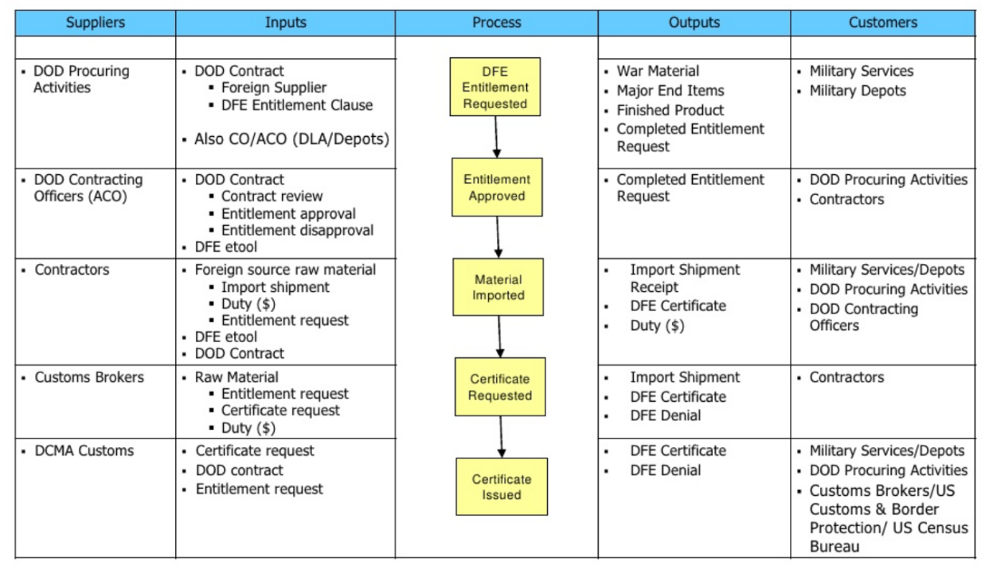
SIPOC
Example:
Date: 09/15/2023

